Slide 1
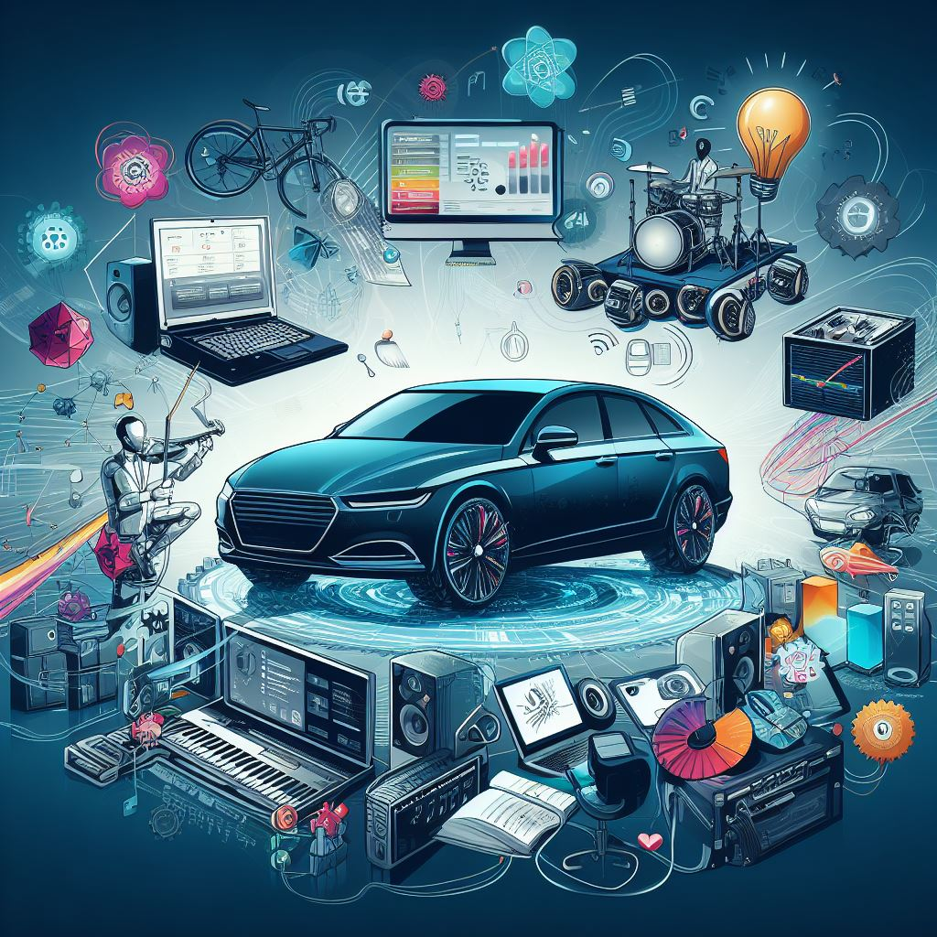

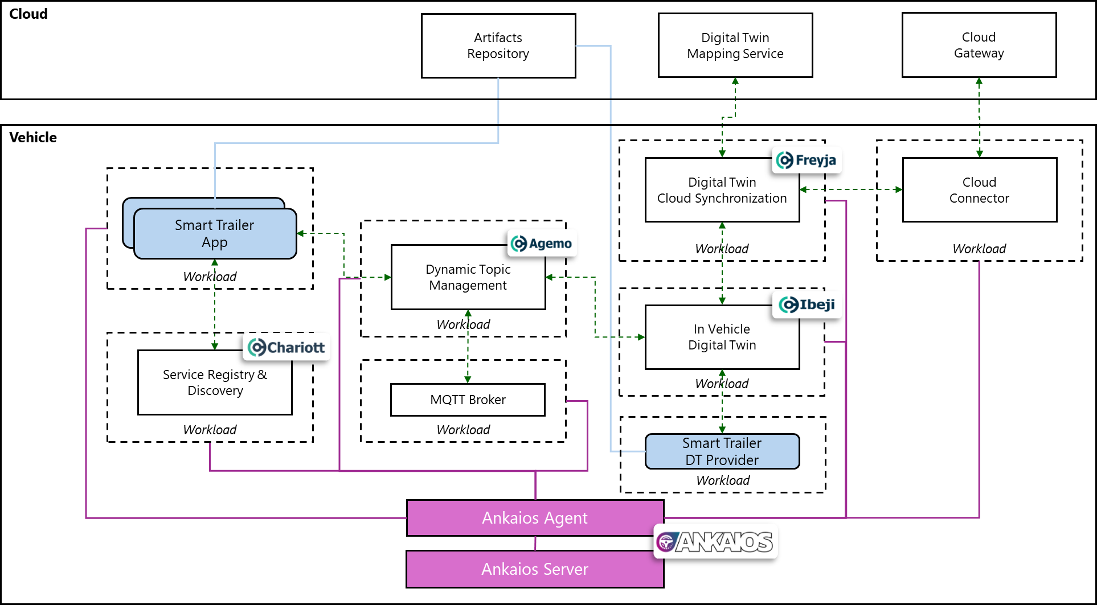
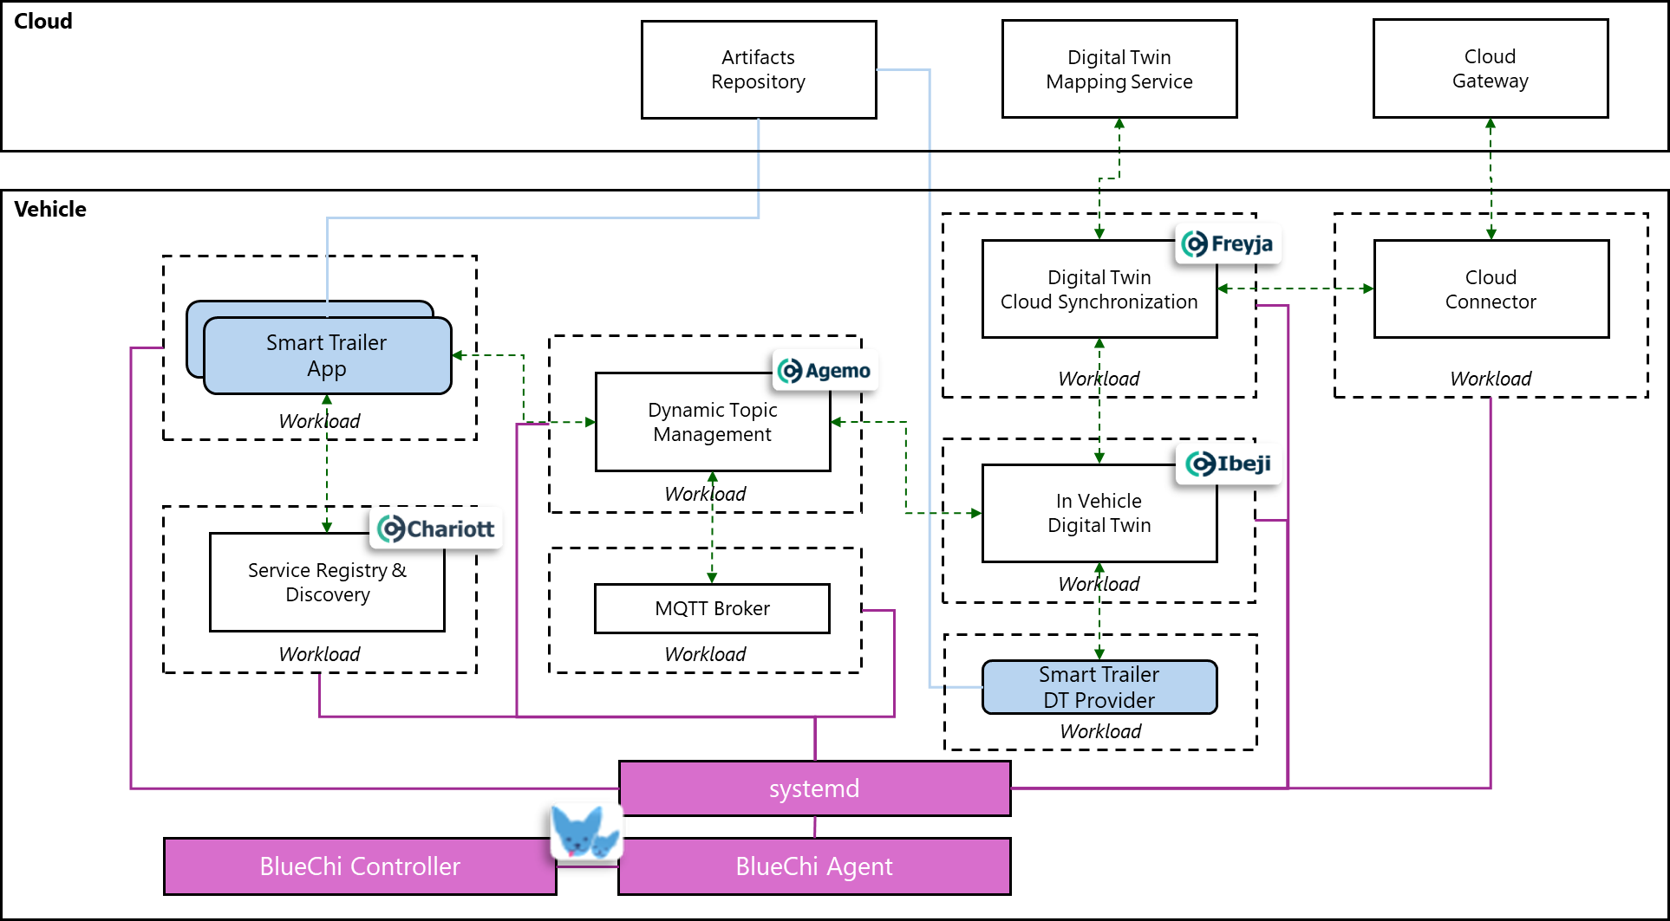
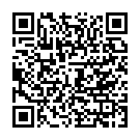
The time is now!
Imagine yourself as the maestro. You are not just writing code. You are composing a masterpiece that will drive the future of transportation. Your work will ensure that every component, from the engine control unit to the infotainment system, works in perfect harmony.
So, step up to the podium, take a deep breath, and let your creativity flow.
Do you want to be the maestro of the next generation of vehicle software?
🚗💻🎶
🚗💻🎶
🚗💻🎶
🚗💻🎶
🚗💻🎶
🚗💻🎶
🚗💻🎶
🚗💻🎶
🚗💻🎶
🚗💻🎶
🚗💻🎶
The stage is set for you to become…
The maestro of in-vehicle software.
Eclipse SDV Hackathon / Maestro Challenge

Slide 2
The time is now!
Imagine yourself as the maestro. You are not just writing code. You are composing a masterpiece that will drive the future of transportation. Your work will ensure that every component, from the engine control unit to the infotainment system, works in perfect harmony.
So, step up to the podium, take a deep breath, and let your creativity flow 🚗💻🎶
Do you want to be the maestro of the next generation of vehicle software?
The stage is set for you to become…
The maestro of in-vehicle software.
Eclipse SDV Hackathon / Maestro Challenge

Slide 3
The time is now!
Imagine yourself as the maestro. You are not just writing code. You are composing a masterpiece that will drive the future of transportation. Your work will ensure that every component, from the engine control unit to the infotainment system, works in perfect harmony.
So, step up to the podium, take a deep breath, and let your creativity flow.
Do you want to be the maestro of the next generation of vehicle software?
🚗💻🎶
🚗💻🎶
🚗💻🎶
🚗💻🎶
🚗💻🎶
🚗💻🎶
🚗💻🎶
🚗💻🎶
🚗💻🎶
🚗💻🎶
🚗💻🎶
The stage is set for you to become…
The maestro of in-vehicle software.
Eclipse SDV Hackathon / Maestro Challenge

Slide 4
The time is now!
Imagine yourself as the maestro. You are not just writing code. You are composing a masterpiece that will drive the future of transportation. Your work will ensure that every component, from the engine control unit to the infotainment system, works in perfect harmony.
So, step up to the podium, take a deep breath, and let your creativity flow 🚗💻🎶
Do you want to be the maestro of the next generation of vehicle software?
The stage is set for you to become…
The maestro of in-vehicle software.
Eclipse SDV Hackathon / Maestro Challenge

